Slide 1
Volag
Data-Driven Analysis of Flight Delays and their Causes
Travis Cox*, Alex Hahn*, Cory Sabol, and Josh Moore

Slide 2
Motivation
8M+ domestic flights per year
600M+ passengers per year
According to our analysis, passengers spent a combined 25 years of delay time in 2015
What are the most significant causes of these delays?
Can we predict future delays?

Slide 3
Goals
Identify causes of flight delays
Focus on weather observations on the day of a particular delayed flight
Find other correlations in data
Predict flight delays
Whether or not a flight will be delayed
How long a flight will be delayed

Slide 4
Data
2015 Flight Delays and Cancellation Data Set
Department of Transportation’s Bureau of Transportation Statistics
5.8M records
Origin and destination airport, scheduled departure and arrival times, origin and arrival delays, delay type, cancellations, etc.
2015 Global Surface Summary of the Day (GSOD) Data Set
National Oceanic and and Atmospheric Administration
4.2M records
Station, temperature, wind speed, precipitation, gust, etc.
Merged data based on airport and weather station proximity

Slide 5
Approach
Performed analysis in Python using Jupyter notebooks
Merged, cleaned, and normalized data sets
Correlation analysis
Statistical analysis
Machine learning
Open science using reproducible results - GitHub and Jupyter notebooks

Slide 6
Merging and Cleaning Data
Connected airports to weather stations based on proximity (many weather stations are actually at airports)
Used weather stations to connect daily weather data to flights
Removed and replaced missing data
Added delay type classifications

Slide 7
Correlation Analysis
Does weather correlate with flight delay?

Slide 8
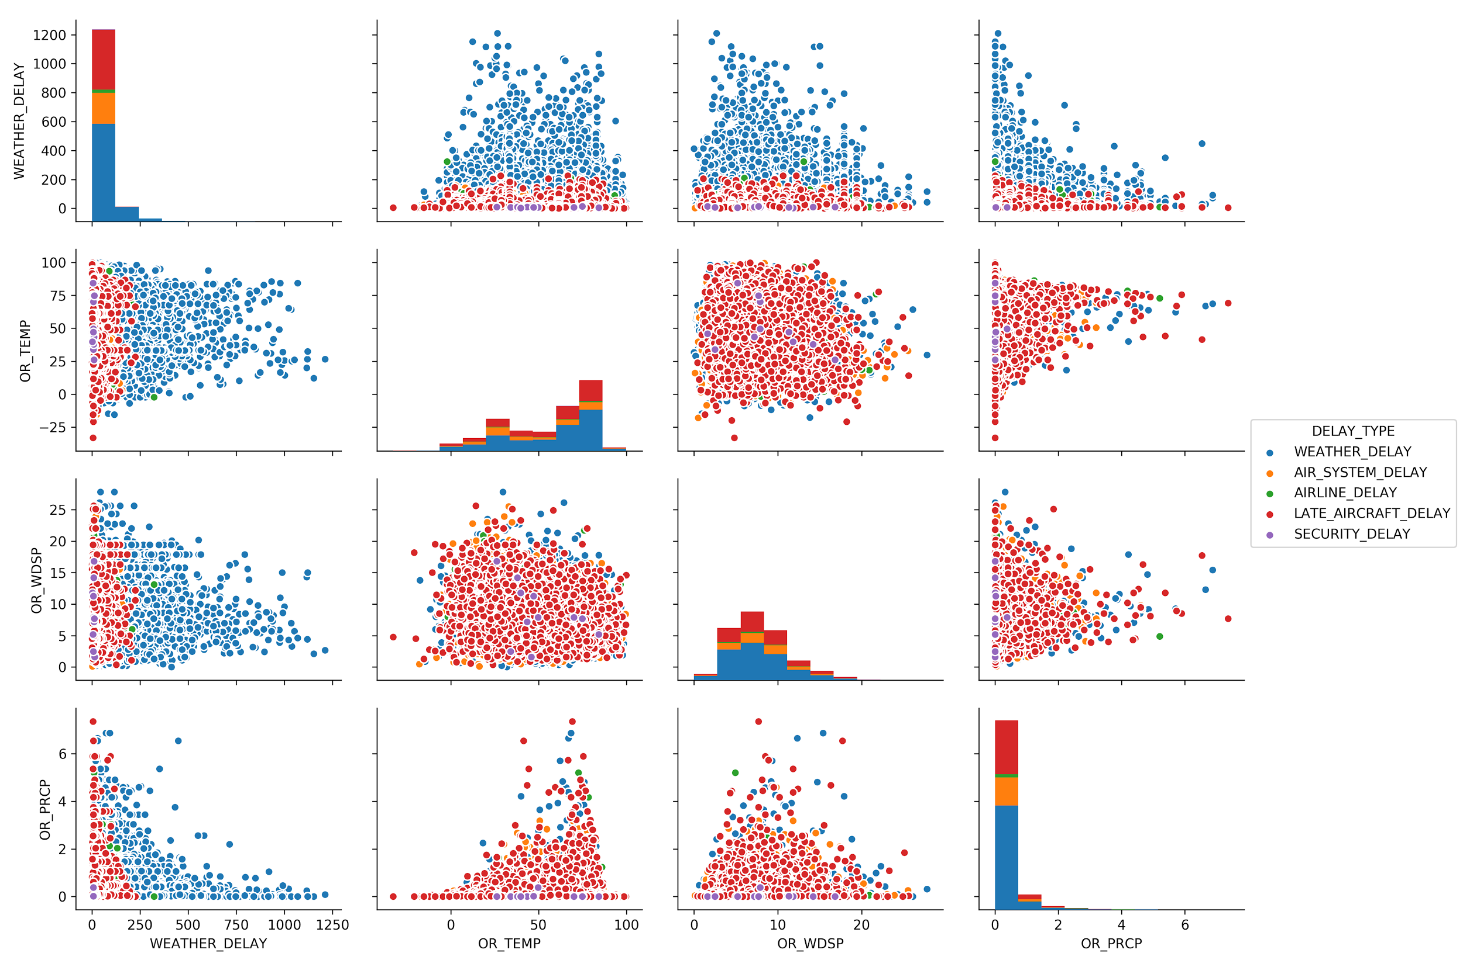
Pair plot of weather features vs. weather-delayed flights
Notes:
Temp and wind speed don’t seem to have very much correlation to weather delay - no obvious shape to plot
Every flight has SOME weather delay.
The colors indicate another, more significant, cause of delay (eg. late aircraft delay)
Precipitation does seem to have a specific exponential shape, but this could be explained by the skew of the data (both delay and precipitation tend to be very low for the majority of values). Also, precipitation has many recorded observations that are 0.

Slide 9
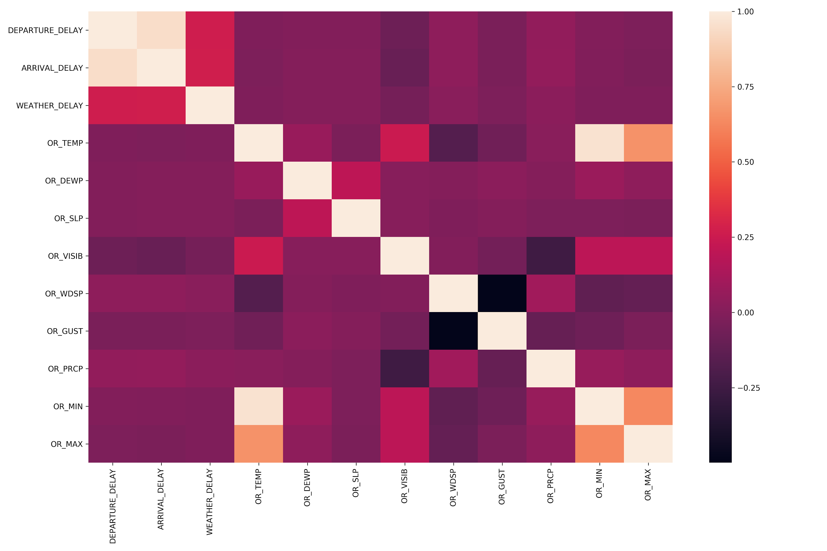
Correlation heatmap of flight delay data vs. weather data

Slide 10
Statistical Analysis
Analyzed mean and median delay times, standard deviations, distribution shapes, etc.
Performed hypothesis testing
Hypothesis (Alternative): the weather is significantly different during delayed flights than it is during non-delayed flights

Slide 11
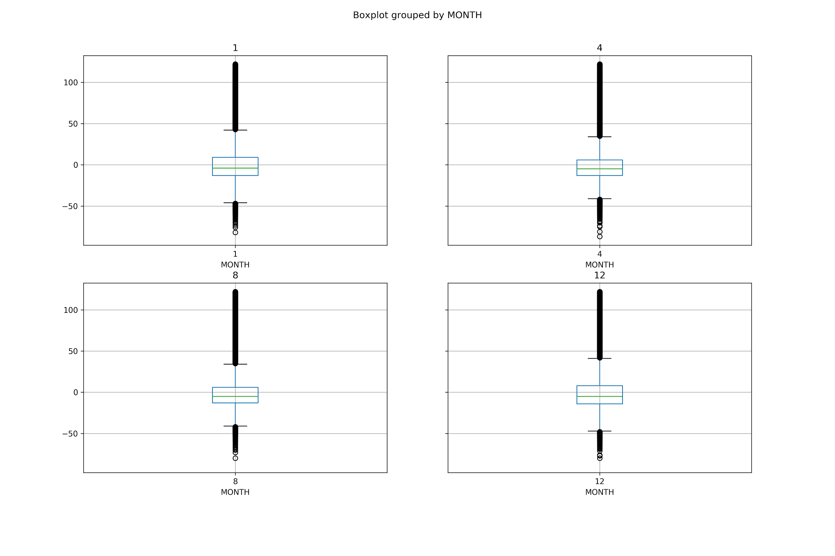
Box Plot Summaries for January, April, August, and December

Slide 12
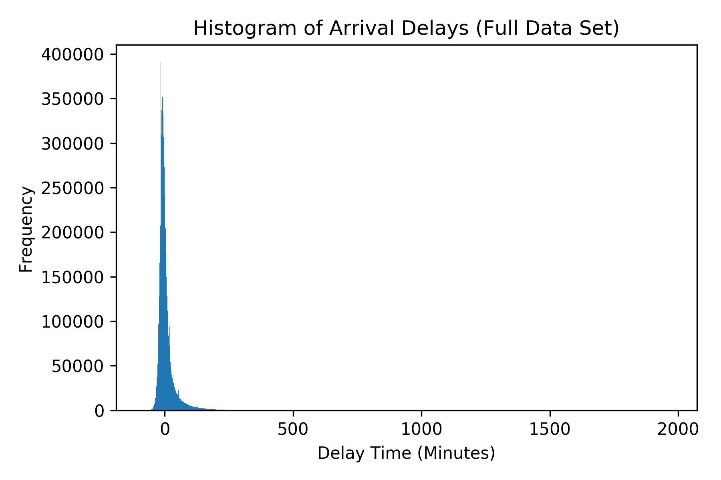
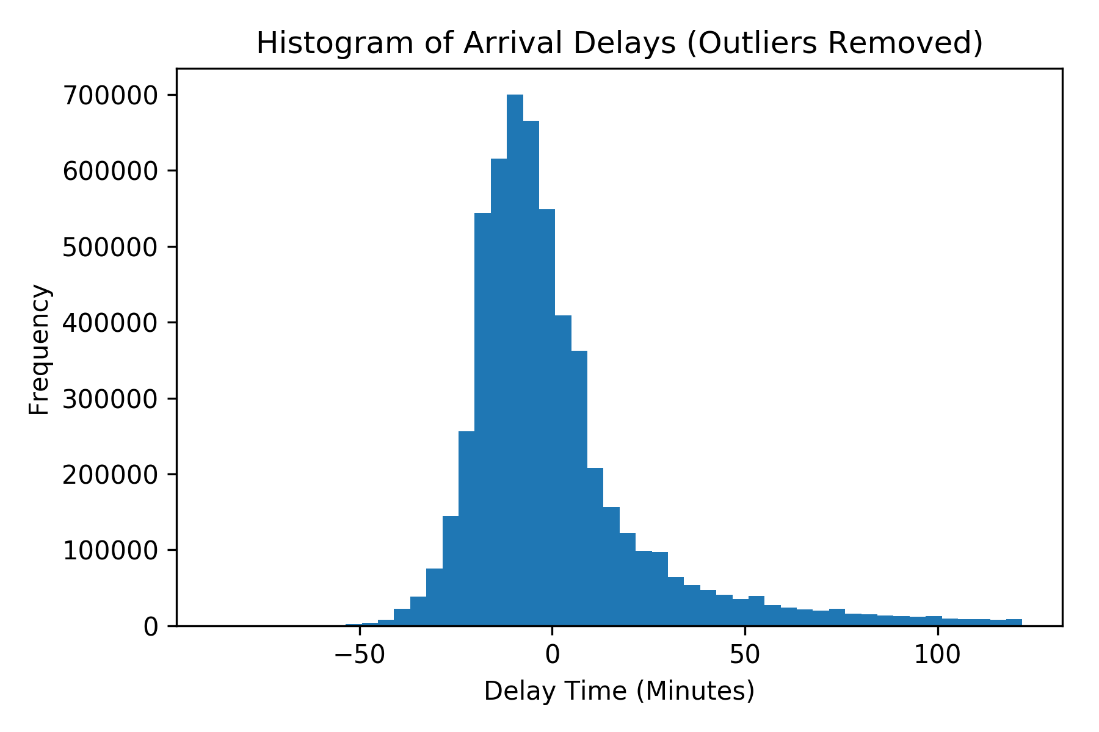
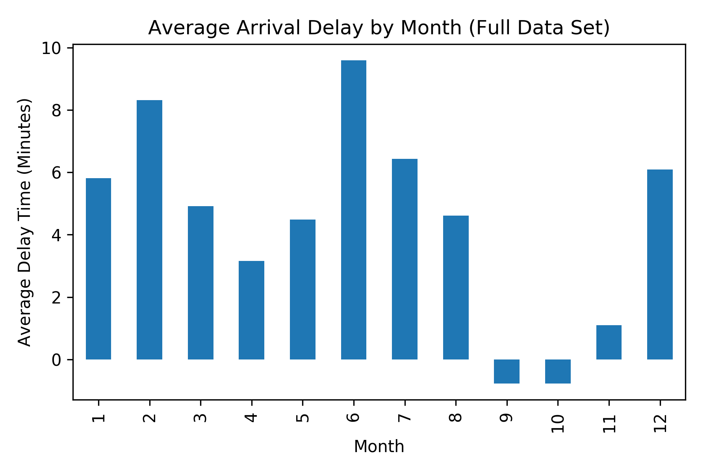
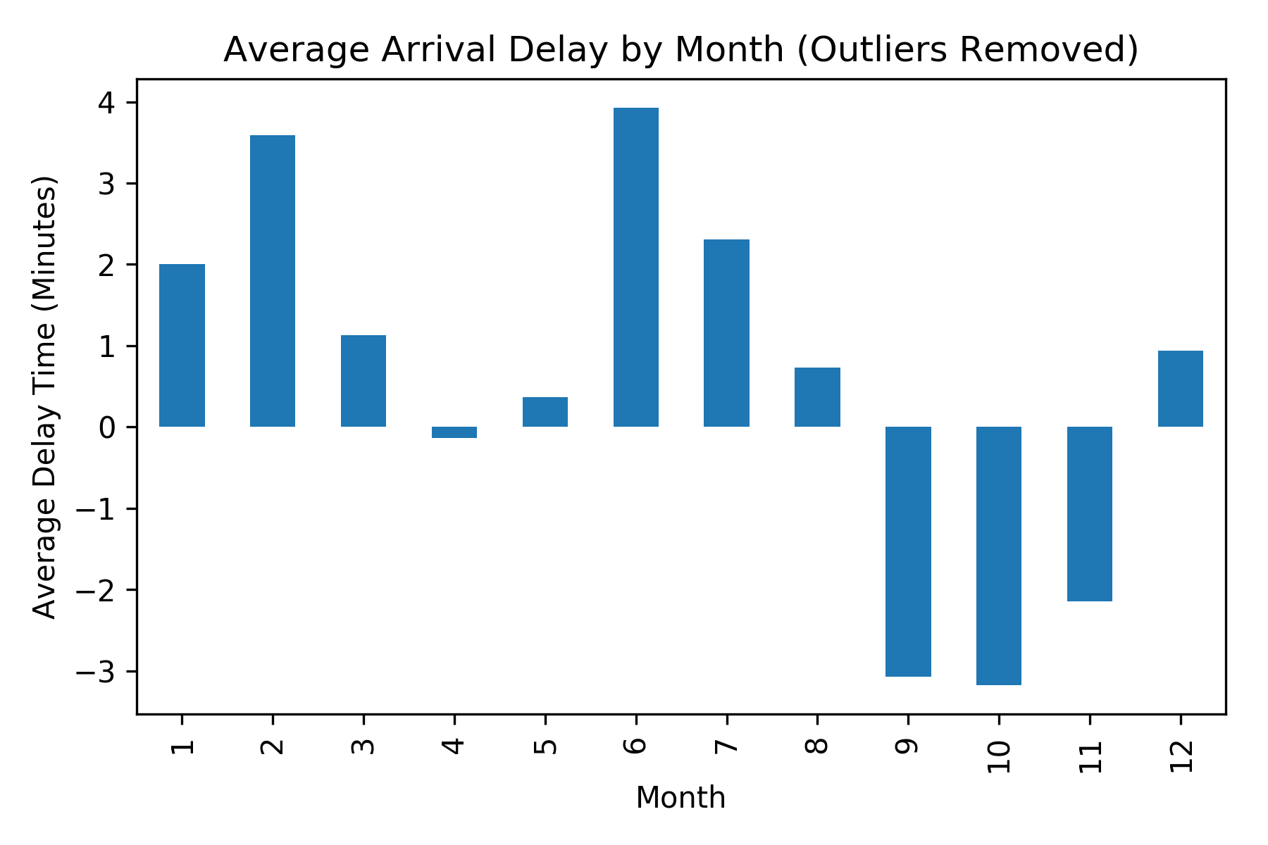

Slide 13
Statistical Analysis - Results
Null Hypothesis: weather feature [x] is not significantly different during delayed flights vs. non-delayed flights
Alternative Hypothesis: weather feature [x] is significantly different during delayed flights vs. non-delayed flights
We were able to reject the null hypothesis (p-value < 0.05) for the following [x] features:
Precipitation
Temperature
Visibility
Wind Speed
Hail
Tornado/Funnel Cloud
… and others

Slide 14
Machine Learning

Slide 15
Classification
Decision Trees
74% accurate classification
Support Vector Machine
On-Time vs. Delayed vs. Cancelled
Delayed vs. Cancelled
 | Predicted On Time | Predicted Delayed | Predicted Cancelled
Actual On Time | 72892 | 19 | 21
Actual Delayed | 824 | 12 | 6
Actual Cancelled | 622 | 3 | 36
 | Predicted Delayed | Predicted Cancelled
Actual Delayed | 762 | 66
Actual Cancelled | 497 | 187
Notes:
SVM 98% accuracy from predicting on time almost every time, 63% accuracy from predicting delayed almost every time.

Slide 16
Regression
Regression Techniques Used
Ridge Regressor
Elastic Net
Stochastic Gradient Descent
Support Vector Regression
All performed almost exactly the same as predicting the mean, except SVR which was worse.
Notes:
In order from best to worst.

Slide 17
Challenges
Heavily skewed data, especially for delays and precipitation
Daily weather data instead of hourly
Large data sets were very slow and resource intensive to process

Slide 18
Conclusion
Found relationships between several weather features and delayed flights
However, unable to build predictive models
Possibly due to daily weather data (opposed to more frequent observations)
Flight delays are very low (< 5 minutes on average)

Slide 19
Conclusion
Multiple causes of flight delays (security, late aircraft, air system, airline)
In our analysis, weather delays actually contributed a very small fraction of the total delays (~64,000 of 5.8M)

Slide 20
Thanks!

